Slide 1
The Power of We:
Using Tech Tools to Promote Collaboration
NCAEE Region 2 Drive-In Conference
Brent Anderson
Onslow County Schools
brent.anderson@onslow.k12.nc.us
@SecondDirect670

Slide 2
Personal Learning Network (PLN)
What is a PLN?
Personal – you create, connect with & share
Learning – gather info or resources, share what you have learned
Network – in school, face-to-face, online, at conferences or through reading, reflecting and sharing

Slide 3
Personal Learning Network (PLN)
Why have a PLN?
Transition to Common Core/Essential Standards
Combat isolation
Budget restrictions
Increase global connections
Develop resources
Ask questions, get suggestions
Keep on top of current trends
Expand your own learning and experiences

Slide 4
Personal Learning Network (PLN)
Benefits of a PLN?
Connect and share
Increase knowledge
Stay current

Slide 5
Personal Learning Network (PLN)
Learn – Part A
Learn – Part B
Collaborate
Dive In
Reflect
Be transparent
Be patient
From Becoming a Techy Teacher by Patti Grayson –
The Connected Teacher: Powering Up
Notes:
Learn – Part A. Take classes. Read posts or books by leaders in the field, or by educators who are having positive experiences in their classrooms. Do professional development workshops or conferences. Being in a Powerful Learning Practice community was transformative for me. PLP has e-courses too.
Learn – Part B. Develop a personal learning network of individuals across the globe who have “been there done that” or want to learn with you. Use Twitter and Twitter hashtags, blogs, or social networking to find educators posting ideas and resources.
Collaborate. Find a buddy to learn with, or a mentor to guide you. There are no stupid questions. Support and encourage each other. If you can’t locate one close by, look for compatible colleagues in online communities, including places like Skype in the Classroom, where the audio, video and texting tools can promote sharing.
Dive in. Start playing – exploring – trying. You won’t break anything. Find out what is out there, and discover tools that will work with your students. Here’s one good website to get you started.
Reflect. Start a blog where you can talk about your experiences. Don’t worry about an audience. In the beginning, a blog’s best purpose is to help you realize what you believe and what is important to you. Here’s mine.
Be transparent. As you begin to develop ideas and lessons, share them with your PLN. Give back to those who helped you grow, and to those who are just starting and will benefit from your experience.
Be patient. Change is never easy, but do you want to be that teacher who just “doesn’t get it?” You will be less confident for a while as you cover yourself with “the new,” and that’s ok. Things are always changing, which means you will always be learning and growing. Much like your students!

Slide 6
How?
Technology allows increased connections and collaboration:
Edmodo
Evernote
Dropbox
Google Drive
Google Docs
Twitter

Slide 7
Edmodo – www.edmodo.com
A free and safe way for students and teachers to connect and collaborate.
Notes:
CCSA 2013 - vbufrz

Slide 8
Evernote – www.evernote.com
Evernote is the easy and powerful way to remember everything, from lifelong memories and vital information to daily reminders and to-do lists.
Everything you store in your Evernote account is automatically synced across all of your devices, making it easy to capture, browse, search and edit your notes everywhere you have Evernote, including smartphones, tablets, computers and on the Web.

Slide 9
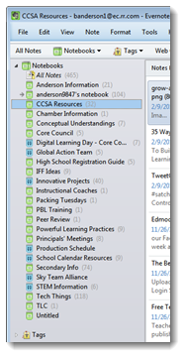
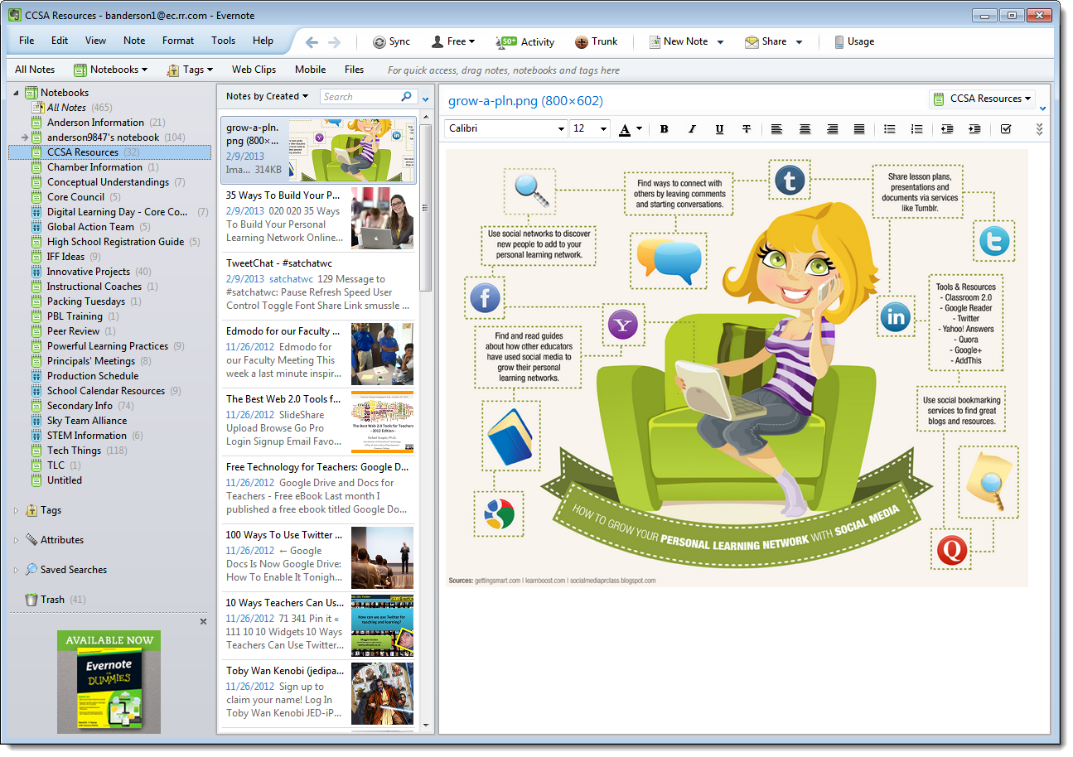
Evernote – www.evernote.com

Slide 10
Dropbox – www.dropbox.com
Dropbox is a free service that lets you bring all your photos, docs, and videos anywhere. This means that any file you save to your Dropbox will automatically save to all your computers, phones and even the Dropbox website.
Dropbox also makes it super easy to share with others, whether you're a student or professional, parent or grandparent.

Slide 11
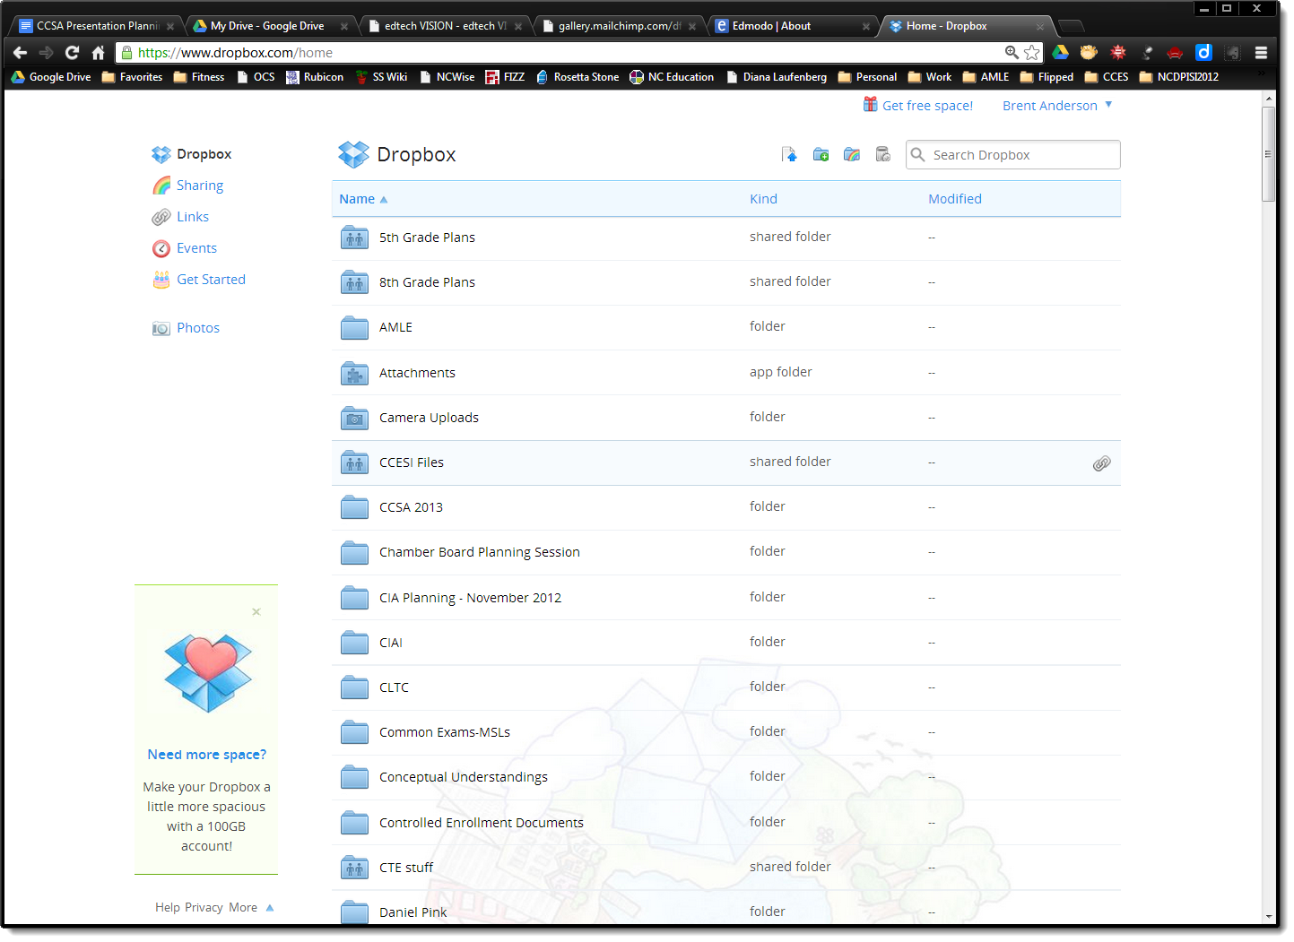
Dropbox – www.dropbox.com

Slide 12
Google Drive – www.google.com
Google Drive lets you store and access your files anywhere -- on the web, on your hard drive, or on the go. Here’s how it works:
Go to Google Drive on the web at drive.google.com.
Install Google Drive on your computer or mobile device.
Throw your files in Google Drive. It’s right there on your device.
Now your files go everywhere you do. Change a file on the web, on your computer, or on your mobile device and it updates on every device where you’ve installed Google Drive. Share, collaborate, or work alone: your files, your choice.

Slide 13
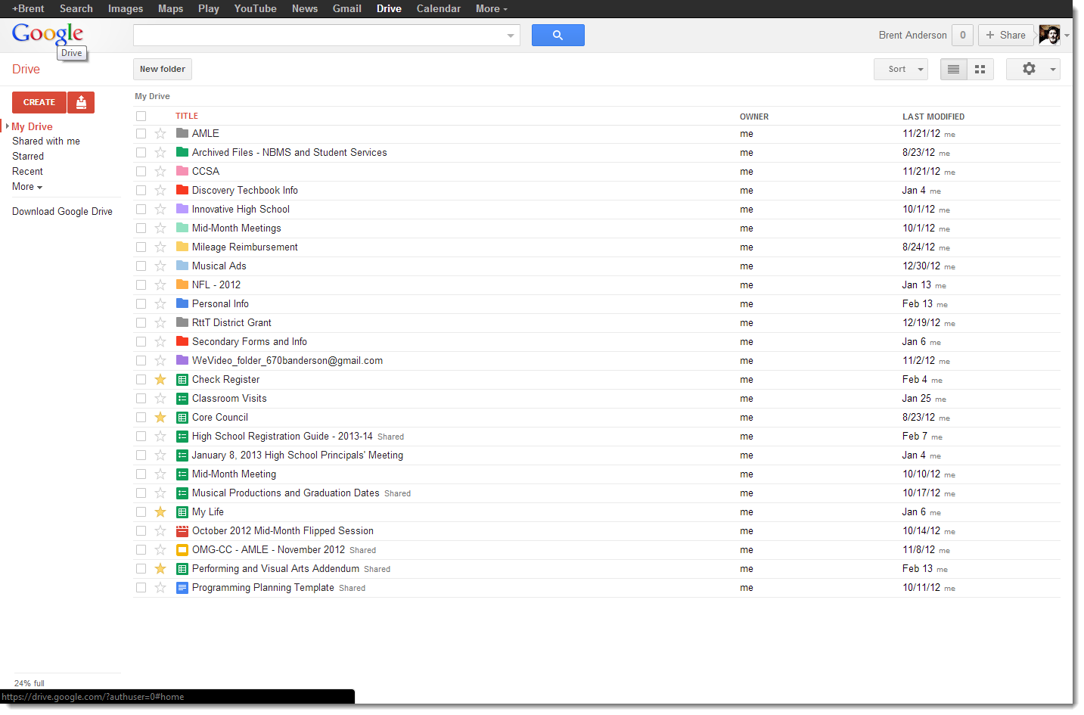
Google – www.google.com

Slide 14
Google Docs – www.google.com
Google Docs is an online word processor that lets you create and format text documents and collaborate with other people in real time.
Google Sheets is an online spreadsheet app that lets you create and format spreadsheets and simultaneously work with other people.
Google Slides is an online presentations app that allows you to show off your work in a visual way.

Slide 15
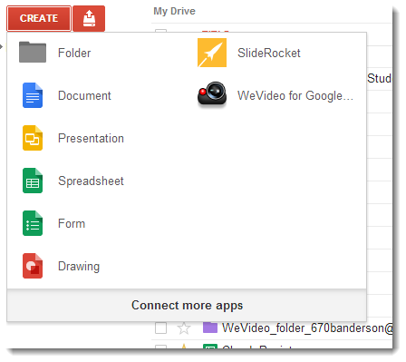
Google Docs – www.google.com

Slide 16
Twitter – www.twitter.com
Twitter is a real-time information network that connects you to the latest stories, ideas, opinions and news about what you find interesting. Simply find the accounts you find most compelling and follow the conversations.
At the heart of Twitter are small bursts of information called Tweets. Each Tweet is 140 characters long, but don’t let the small size fool you—you can discover a lot in a little space. You can see photos, videos and conversations directly in Tweets to get the whole story at a glance, and all in one place.

Slide 17
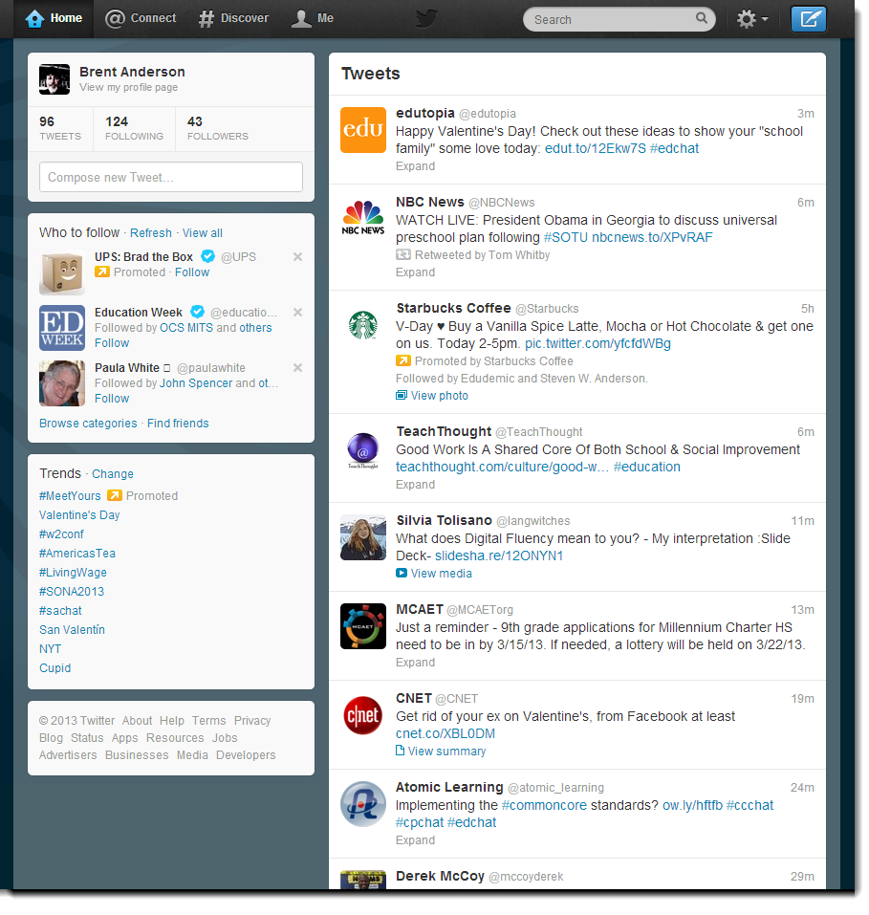
Twitter – www.twitter.com

Slide 18
Susanne Long
Onslow County Schools
susanne.long@onslow.k12.nc.us
@statesideelem
Brent Anderson
Onslow County Schools
brent.anderson@onslow.k12.nc.us
@SecondDirect670

