Slide 1
Fraction Action
Presented by:
Michelle (Shelly) Alford

Slide 2
Welcome
Thank you for taking time on a Saturday to come to the NCAEE conference.
This shows such an amazing level of dedication to your profession.
I hope you leave with something you will be able to use in your classroom on Monday.

Slide 3
Why did you sign up?
What do you hope to get out of our time together today?
What part of fractions do you feel your kids struggle with the most?
How do you feel about fractions?
Notes:
Put the responses to these questions on chart paper so that you can make sure they have been answered at the end of the session.

Slide 4
Questions to ask you students?
Are fractions numbers?
Do we ask this explicitly? Not tell, but ask?
What is the usual answer?
Overwhelmingly – NO!!! The reasoning behind why are varied, but by and far the largest majority of students answer no!

Slide 5
Verbal or Written
Then do we ask the next level of questioning?
Do we ask our students these questions then move on to the doing of fractions?
Do we ask our students to write their answers? Without frontloading?

Slide 6
Why a Fraction a Number?
Why is it a number?
What are the usual answers?
Because it has numbers.
Because it is part of something.
Because it is what my teacher said.

Slide 7
PLAY TIME!
Task 1
How many different ways can you divide your geoboard in half?
Record on the geoboard grid paper.

Slide 8
Keep Playing
Task 2
Divide your geoboard in fourths using a variety of ways.
Record on the geoboard grid paper.
Write an explanation proving that the pieces are fourths.

Slide 9
Understand fractional parts must be equal-sized.
Example
Non-example
What are some ways we can make this more concrete for our students?

Slide 10
Anchor Charts
Equal Parts
Just Parts

Slide 11
Formative Assessment
This was taken from the 3rd grade unpacking documents.
Are each of these a fraction?
How do you know?

Slide 12
What had DPI done for me lately?

Slide 13
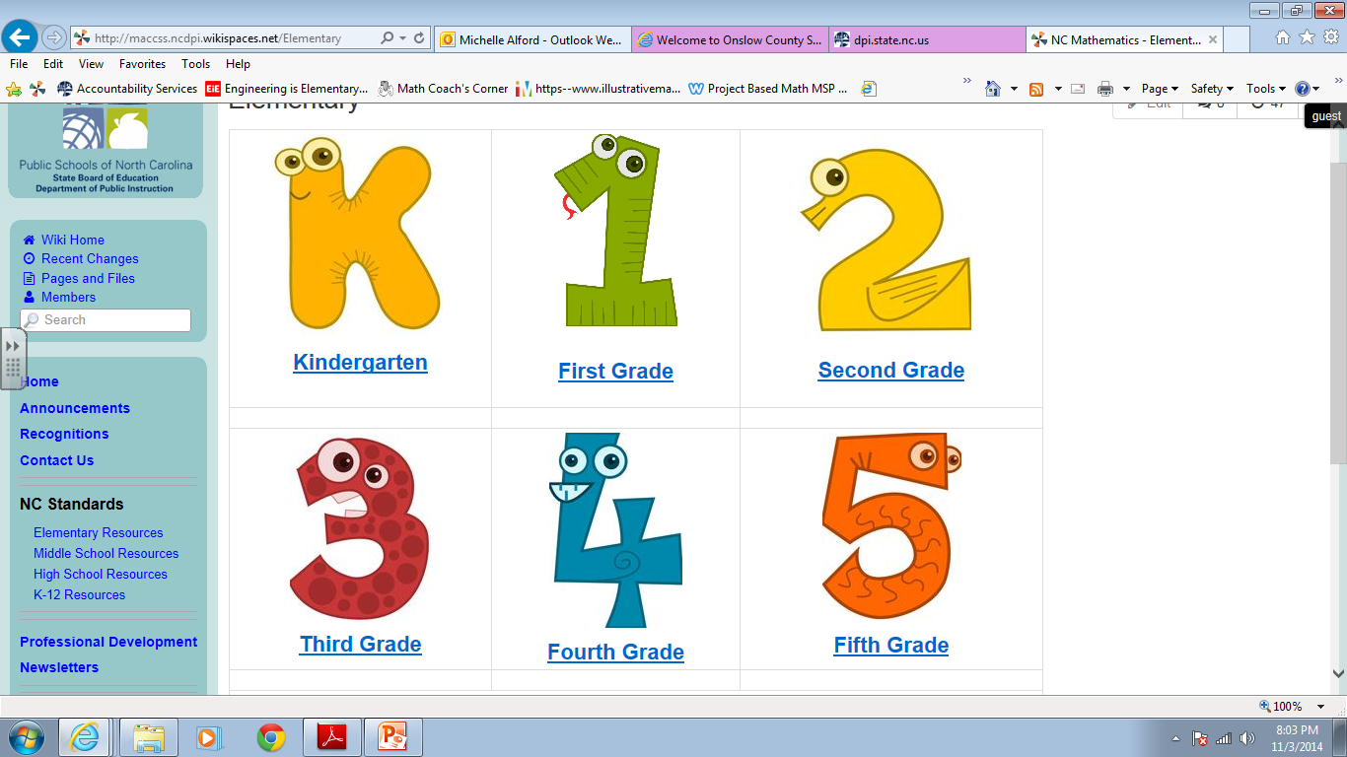

Slide 14
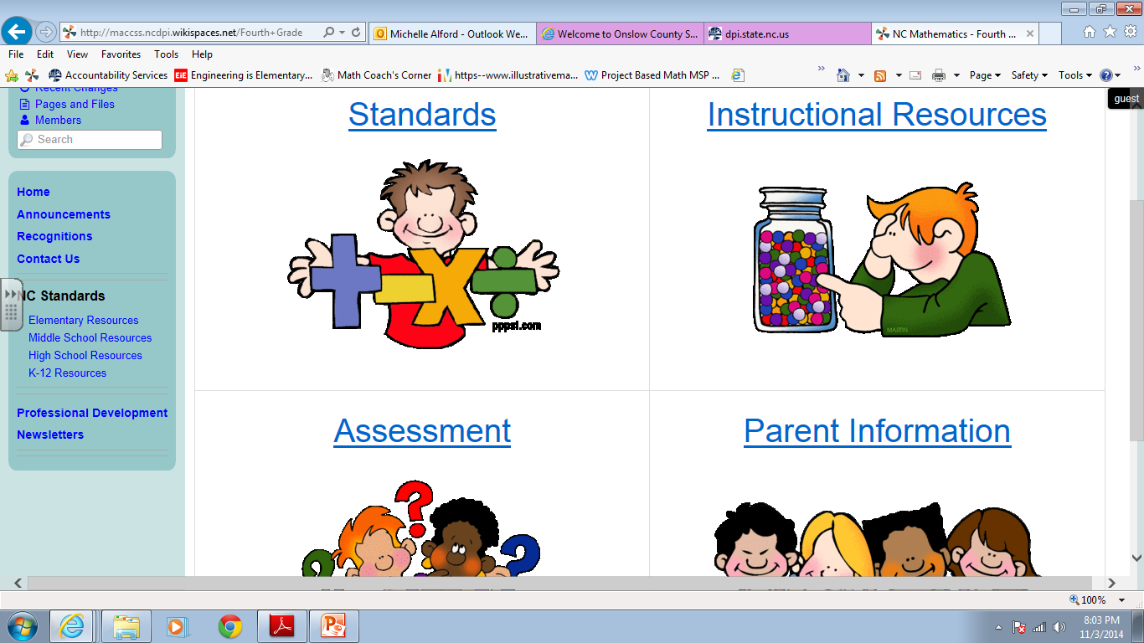

Slide 15
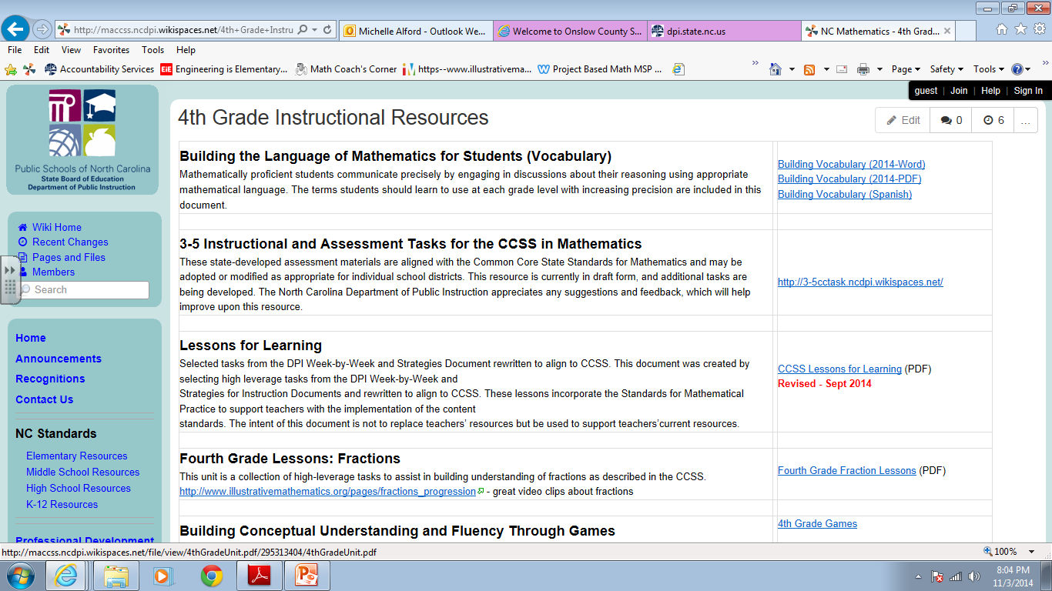

Slide 17
Questions

Slide 18
Michelle.alford@onslow.k12.nc.us

